Slide 1

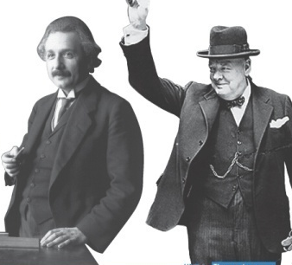

3
Unit 1 Section A
Never, ever give up!
FOREIGN LANGUAGE TEACHING AND RESEARCH PRESS
AIR FORCE ENGINEERING UNIVERSITY
Notes:
1

Slide 2

Language focus
Functional patterns
Functional Patterns | Functions & Usages
1. A, B, C – none of these be/do… | 用于表达“对已知条件的否定”。
2. Sb. do sth., not because …, but because … | 用于表达“某人做某事的原因”。
3. It’s not … that matters. It’s …that be/do… | 用于表达“对某事物最为重要的因素是……”。
Notes:
2

Slide 3
Language focus
Practical phrases
Practical Phrases | Specific Meanings
1. deviate from … | 偏离，背离……
2. preclude sb. from doing … | 阻止某人做……
3. triumph over … | 战胜……
4. in (the) pursuit of … | 追求……
5. work one’s way to/through/into… | 通过奋斗逐步达到
6. give up on … | 放弃……
7. focus on … | 专注于……

Slide 4

Language focus
Practical phrases
偏离，背离……
短语逆译
deviate from …
短语应用
有人生目标的人是永远不会偏离正确航向的。
意群提示
(life compass/correct course)
Those who have a life compass in their mind will never deviate from the correct course.

Slide 5
Language focus
Practical phrases
preclude sb. from doing …
阻止某人做……
短语逆译
短语应用
有志者事竟成。
意群提示
(willing heart / to achieve success)
Nothing can preclude a willing heart from achieving success.

Slide 6
Language focus
Practical phrases
战胜……
短语逆译
triumph over …
短语应用
中国人民只要万众一心，必将战胜任何困难，从而立足于世界之巅。
意群提示
(to work with one heart and one mind/to stand on top of the world)
As long as the Chinese people work with one heart and one mind, they will triumph over any difficulties and stand on top of the world.

Slide 7
Language focus
Practical phrases
追求……
短语逆译
in (the) pursuit of …
短语应用
一个国家在追求经济发展的同时，应当对环境保护给予足够重视。
意群提示
(to give due emphasis to)
While in pursuit of economic growth, a nation should give due emphasis to the protection of the environment.

Slide 8
Language focus
Practical phrases
work one’s way to/through/into …
通过奋斗逐步达到
短语逆译
短语应用
通过激烈的竞争进入大学的同学们应当将大学教育作为人生奋斗的新起点而非终点。
意群提示
( to take … as / life endeavor )
Students who have fiercely worked their way into universities should take college education as a new starting point rather than the finishing line of their life endeavor.

Slide 9
Language focus
Practical phrases
放弃……
短语逆译
give up on …
短语应用
在地震过后的搜救工作中，解放军战士不放弃任何生命迹象。
意群提示
(search and rescue work/life signs)
In the search and rescue work after the earthquake, the PLA soldiers didn’t give up on any life signs.

Slide 10
Language focus
Practical phrases
专注于……
短语逆译
focus on …
短语应用
大学生应将主要精力专注于学习而不是各种令其分心的事物。
意群提示
(various distractions)
College students should focus most of their energy on studies rather than on various distractions.

Slide 11
Language focus
Functional patterns
Functional Patterns | Functions & Usages
1. A, B, C – none of these be/do… | 用于表达“对已知条件的否定”。
2. Sb. do sth., not because …, but because … | 用于表达“某人做某事的原因”。
3. It’s not … that matters. It’s …that be/do… | 用于表达“对某事物最为重要的因素是……”。
Notes:
11

Slide 12
Language focus
Functional patterns
原句译文
个人经历、教育机会、个人困境，这些都不能阻挡一个全力以赴追求成功的、有着坚强意志的人。
逆译练习
Personal history, educational opportunity, individual dilemmas— none of these can inhibit a strong spirit committed to success.
句型提炼
Notes:
12

Slide 13

Language focus
Functional patterns
句型提炼
A, B, C — none of these be/do…
应用提示
用于表达“对已知条件的否定”。
句型应用
Notes:
13

Slide 14
Language focus
Functional patterns
典型例句
金钱、名誉、社会地位，这些都不应作为判断一个人是否成功的唯一标准。
意群提示
( to be regarded as/standard for )
Money, fame, social status — none of these should be regarded as the only standard for the judgment of one’s success.

Slide 15
Language focus
Functional patterns
原句译文
他们取得了成功，并不是因为成功很容易，而是因为他们拥有克服重重障碍的
意志，为了追求目标而勤奋努力。
逆译练习
They attained success, not because it was easy, but because they had the will to overcome profound obstacles and to work diligently in the pursuit of their goals.
句型提炼
Notes:
15

Slide 16
Language focus
Functional patterns
句型提炼
Sb. do sth., not because …, but because …
应用提示
用于表达“某人做某事的原因”。
句型应用
Notes:
16

Slide 17
Language focus
Functional patterns
典型例句
我选择厚道，不是因为我笨拙，而是因为我深信，厚德能载物。
意群提示
(honest and kind/ great virtue/hold the world)
I choose to be honest and kind, not because I am stupid, but because I firmly believe that great virtue holds the world.

Slide 18
Language focus
Functional patterns
原句译文
你摔倒了多少次并不要紧；你能多少次重新站起来对成功才至关重要！
逆译练习
It’s not how many times you fall down that matters. It’s how many times you get back up that makes success!”
句型提炼
Notes:
18

Slide 19
Language focus
Functional patterns
句型提炼
It’s not … that matters. It’s … that be/do…
应用提示
用于表达“对某事物最为重要的因素……”。
句型应用
Notes:
19

Slide 20
Language focus
Functional patterns
典型例句
要获得成功，你现在的位置不重要，重要的是你前进的方向。
意群提示
(current position/to head for)
It’s not where your current position is that matters. It’s where you are heading for that leads you to success.

Slide 21


Language focus
Language appreciation
年轻人，要永不放弃。永不放弃！永不放弃！永不，永不，永不，永不！
a. Young men, never give up. Never give up! Never give up! Never, never, never, never! (Para.2, L6)

Slide 22
Language focus
Language appreciation
任务再苦，准备再长，难度再大，都不能放弃自己的追求。
b. No task is too hard. No amount of preparation is too long or too difficult. (Para.3, L2)

Slide 23
Language focus
Language appreciation
然而，坚强的意志鞭策着他，推动他前进，使他更加乐观、投入、坚毅。
c. Yet his strong will was the spur that pushed him forward, strengthening his optimism, dedication and determination. (Para.4, L6)

Slide 24
Language focus
Language appreciation
只有那些“执着地追求成功”的人，那些保持始终如一的精神意志的人，才会通过自身的努力，获得成功。
d. Only those who “keep their eyes on the prize”, those who uphold a committed and focused will and spirit, will find their endeavors successful. (Para.5, L1)

Slide 25
Language focus
Language appreciation
你摔倒了多少次并不要紧；你能多少次重新站起来对成功才至关重要！
e. It’s not how many times you fall down that matters. It’s how many times you get back up that makes success! (Para.7, L5)

Slide 26

Language focus
Language appreciation
只要刻苦努力，意志坚决，专心投入，准备充分，你就能跨越一切障碍，达成所有壮举，取得成功！
f.With hard work, determination, dedication and preparation, you can transcend any handicap, accomplish any feat, and achieve success! (Para.8, L4)

Slide 27
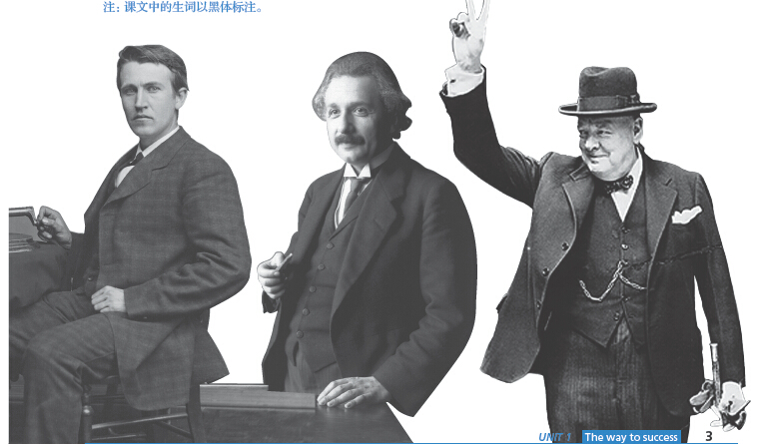
Section A
Never, ever give up!
The end

